Slide 1

Become a Better C# Developer
Kathleen Dollard
kathleen.dollard@Microsoft.com
https://github.com/kathleendollard
@KathleenDollard
Bill Wagner
wiwagn@Microsoft.com
https://github.com/billwagner
@BillWagner

Slide 2
Abstract
You’re an intermediate to advanced C# programmer, and you know how important it is to stay up to date. However, you keep wondering if you’re effectively using all the new features and fundamental aspects of C# and .NET.
We all develop habits, and you'll be at your best if you constantly examine those habits. Keep the ones that make you better and change the ones that are holding you back. This workshop uses three themes to guide you on that journey.
You’ll examine and refresh your assumptions about C#. Are you sure that your assumptions are correct, and aren’t setting you up for nasty surprises? Learn more about timeless aspects of C# and how to avoid pitfalls when you use everyday techniques like:
Garbage collection and managing managed memory
The intricacies of method overloads
Avoiding issues with numbers and dates
Then you’ll take a deep dive into a set of techniques you can use to make your code better. Better means shorter, easier to comprehend, and more robust. You’ll learn more about each of these techniques and how they work together:
Generics, iterators, and interfaces
Pattern matching
Functional techniques in C#
And finally, you’ll learn about new features and practices. The tools you use every day have evolved to support code that is easier to create and significantly less error-prone. Learn how .NET is evolving, and how to incorporate these features into your daily work, or plan your upgrade strategy:
Nullable reference types to reduce exceptions
Editor tools to enforce code style
Async streams for responsive apps
Index and range syntax for simplicity
This workshop will be a combination of presentations, thought experiments and hands-on exercises. Most of the material can be applied to older versions of C# (most is also valid for Visual Basic.NET), but you’ll want a laptop with C# 7.3 or C# 8.0 for the workshop. You have one of these installed on your machine if you have Visual Studio 2017 Update 9, Visual Studio 2019, or .NET Core 3.0.
The goals of this workshop are to give you skills and ways of thinking that will make you a better C# programmer immediately, and approaches which you can use to continually improve.

Slide 3
Puzzle
Review
Code
Code under review

Slide 4

What tools?
Visual Studio? Code? Other?
What version of tools?
Plans for .NET Core?
C#? Which C#? C# 8?
High volume/large datasets?
High performance/throughput?
Desktop or web or mobile?
Cloud and container strategy?
Source control strategy

Slide 5
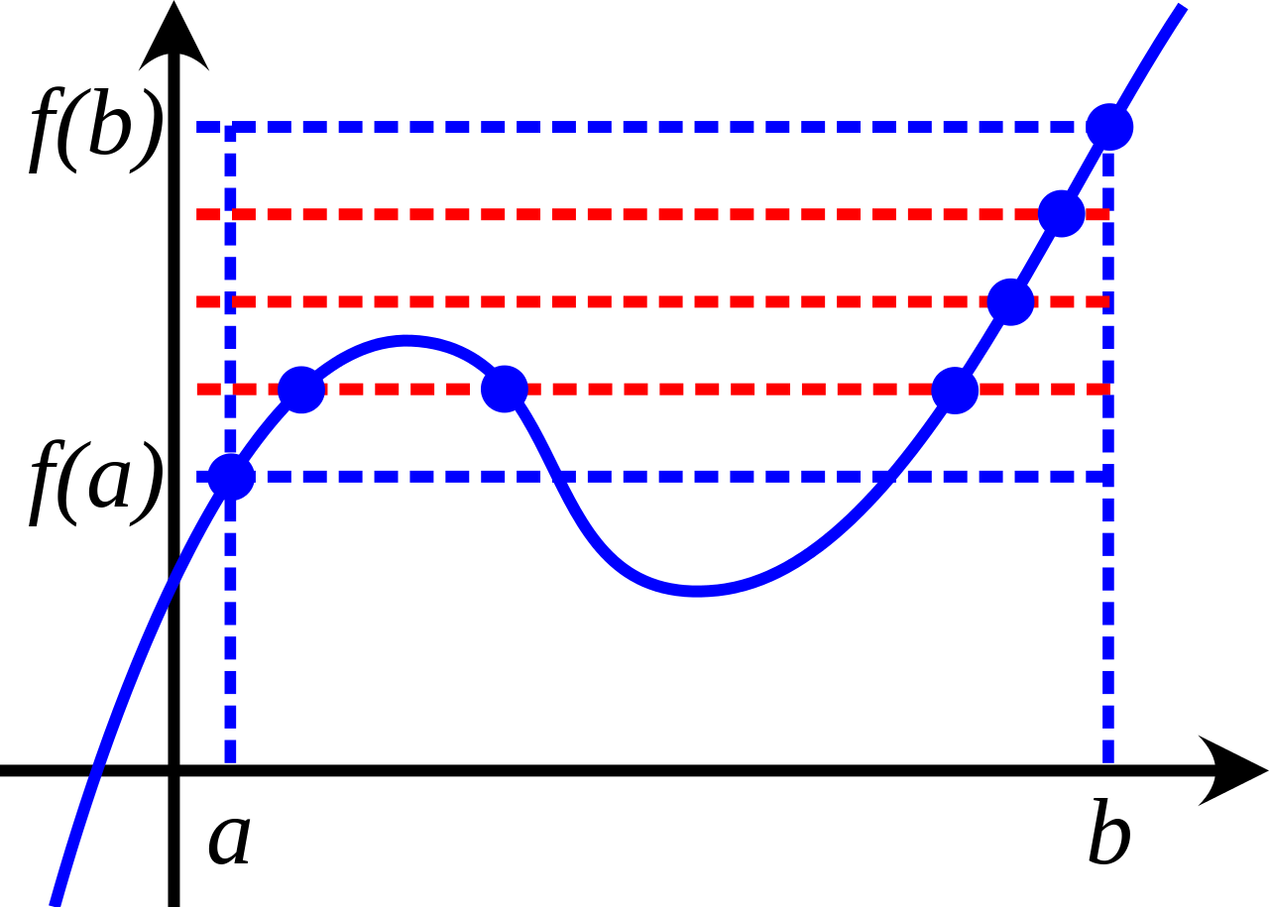
Intermediate to Advanced
We all know more about some things and less about others
We always wonder what we’re missing
New learning “sticks” better in the context of fundamentals
You’ll forget a lot by Monday
Link to materials at end

Slide 6

Morning
9:30 - 11:00 Session
11:00 - 11:30 Break
11:30 - 13:00 Session
Lunch
13:00 - 14:00 Lunch
Afternoon
14:00 – 15:30 Session
15:30 – 16:00 Break
16:00 – 17:30 Session

Slide 7
Week at a Glance
Monday
Timeless
Types and Memory
Async
Tuesday
Deep Dive
Async
Functional Styles
Wednesday
Timely
C# 8
Editor tools to enforce style

Slide 8
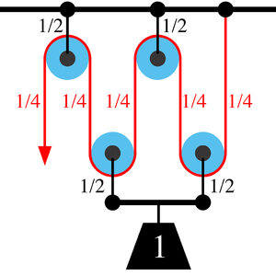
You will work together
We’re counting on you to ask questions
We don’t know everything
We’ll adjust due to pace and focus on your interests
Wednesday afternoon you’ll create a summary as a group

Slide 9

Morning A:
Opening Code Review
Intro, mechanics assumptions
Intricacies of method overloads
Morning B:
Iterators, interfaces, and generics
Surprising type details (numerics)
Afternoon C:
Empowering the compiler - Readonly
Intro to Async
Afternoon D:
Managing managed memory
Making safe from unsafe
This Photo by Unknown Author is licensed under CC BY

Slide 10

Monday Timeless
Morning A:
Opening Code Review
Intro, mechanics assumptions
Intricacies of method overloads
Morning B:
Iterators, interfaces, and generics
Surprising type details (numerics)
Afternoon C:
Empowering the compiler - Readonly
Intro to Async
Afternoon D:
Managing managed memory
Making safe from unsafe

Slide 11

DEMO
Puzzles!!

Slide 12


Slide 13
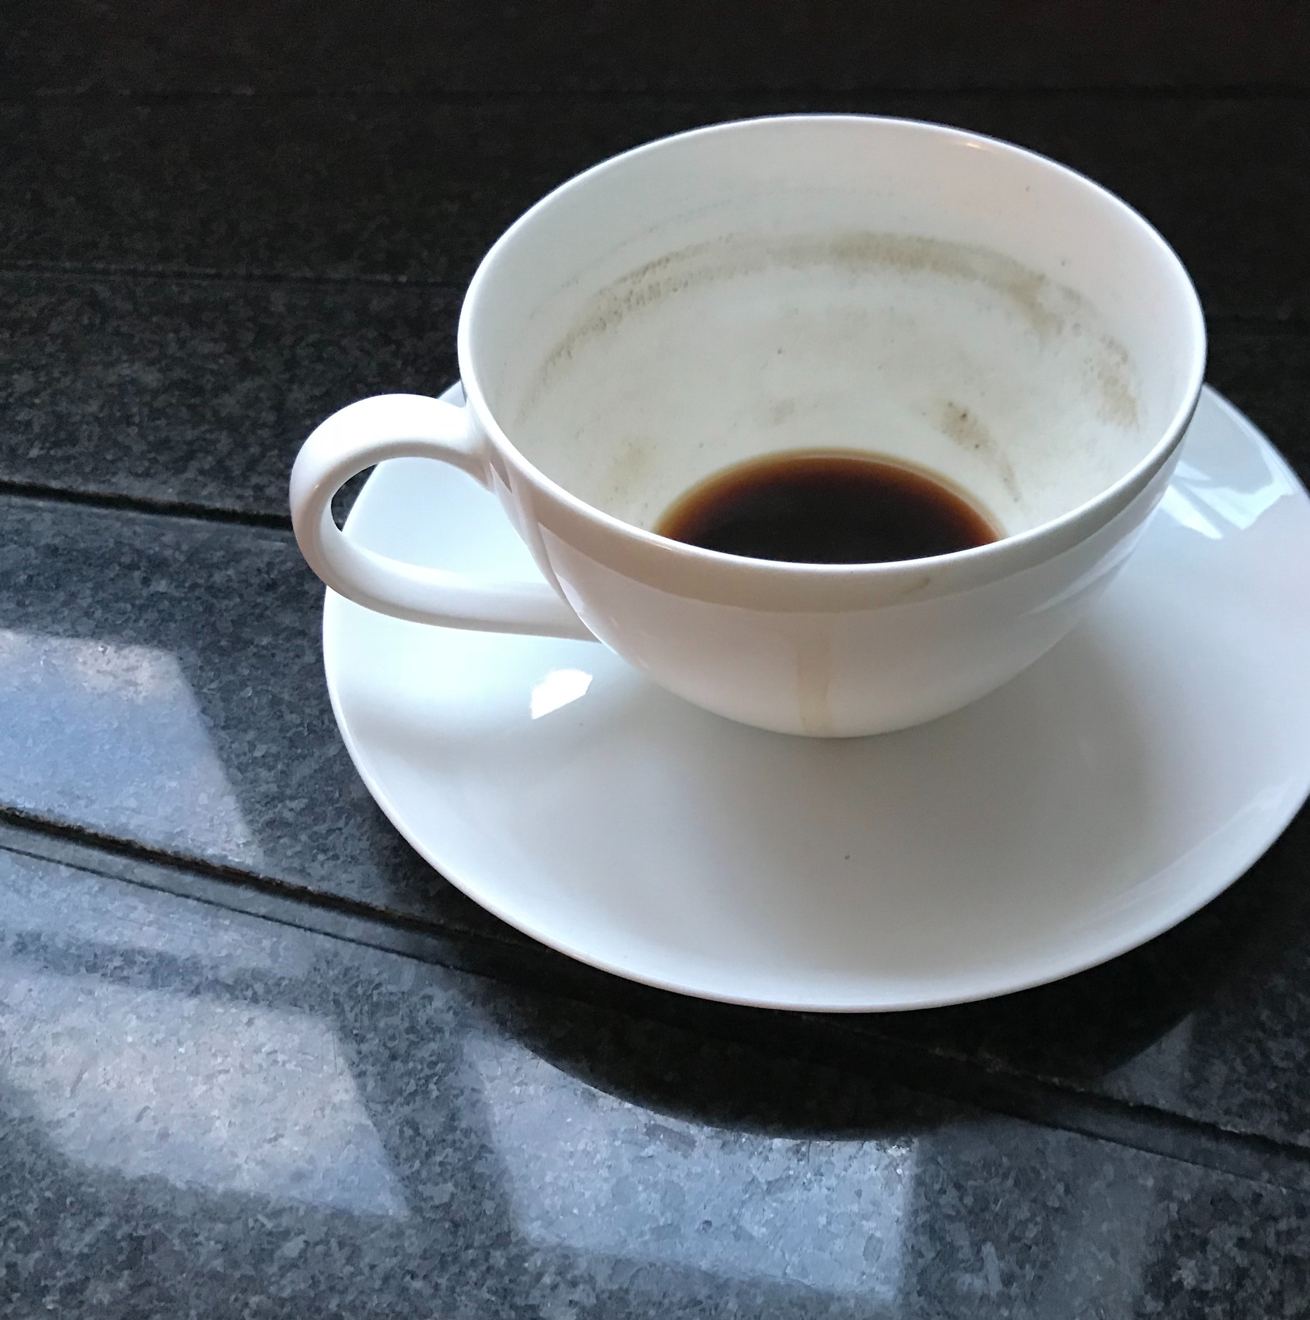
Break

Slide 14
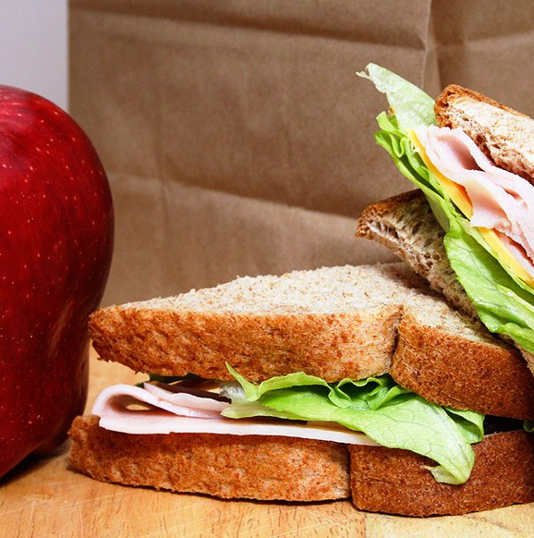
Lunch

Slide 15
Iterators, interfaces, generics
Other deck

Slide 16
DEMO
Puzzles!!

Slide 18

DEMO
Thinking!!

Slide 19

DEMO
Lab!!

Slide 20
DEMO
Lab!!

